Slide 1

What You Need to Know About InfoSec
and Why You Should Care
Paul Gilzow
Notes:
infosec is a very broad discipline

Slide 2
The What and Why of
WordPress Security
Make sure to submit questions during this presentation via Twitter. Use the hashtag #WPCampus and @gilzow (me). You’ll earn points toward the conference game for each question you submit!

Slide 3
The What and Why of
WordPress Security
Make sure to submit questions during this presentation through the WPCampus website! You’ll earn points toward the conference game for each question you submit!
https://2018.wpcampus.org/schedule/security-chat-for-everyone/

Slide 4

Language Explanation
Internet Engineering Task Force RFC 2119’s verbiage for indicating requirements
MUST and MUST NOT indicate non-optional requirements
SHOULD and SHOULD NOT indicate recommendations for which exceptions may exist
MAY indicates truly optional requirements

Slide 5
TL;DR
Minimizing Risk
Notes:
to support the success of the organization’s mission

Slide 6
What is “Risk”?
Risk is the intersection of assets, threats, and vulnerabilities
Notes:
the probability for a threat to occur X the impact of it occurring

Slide 7
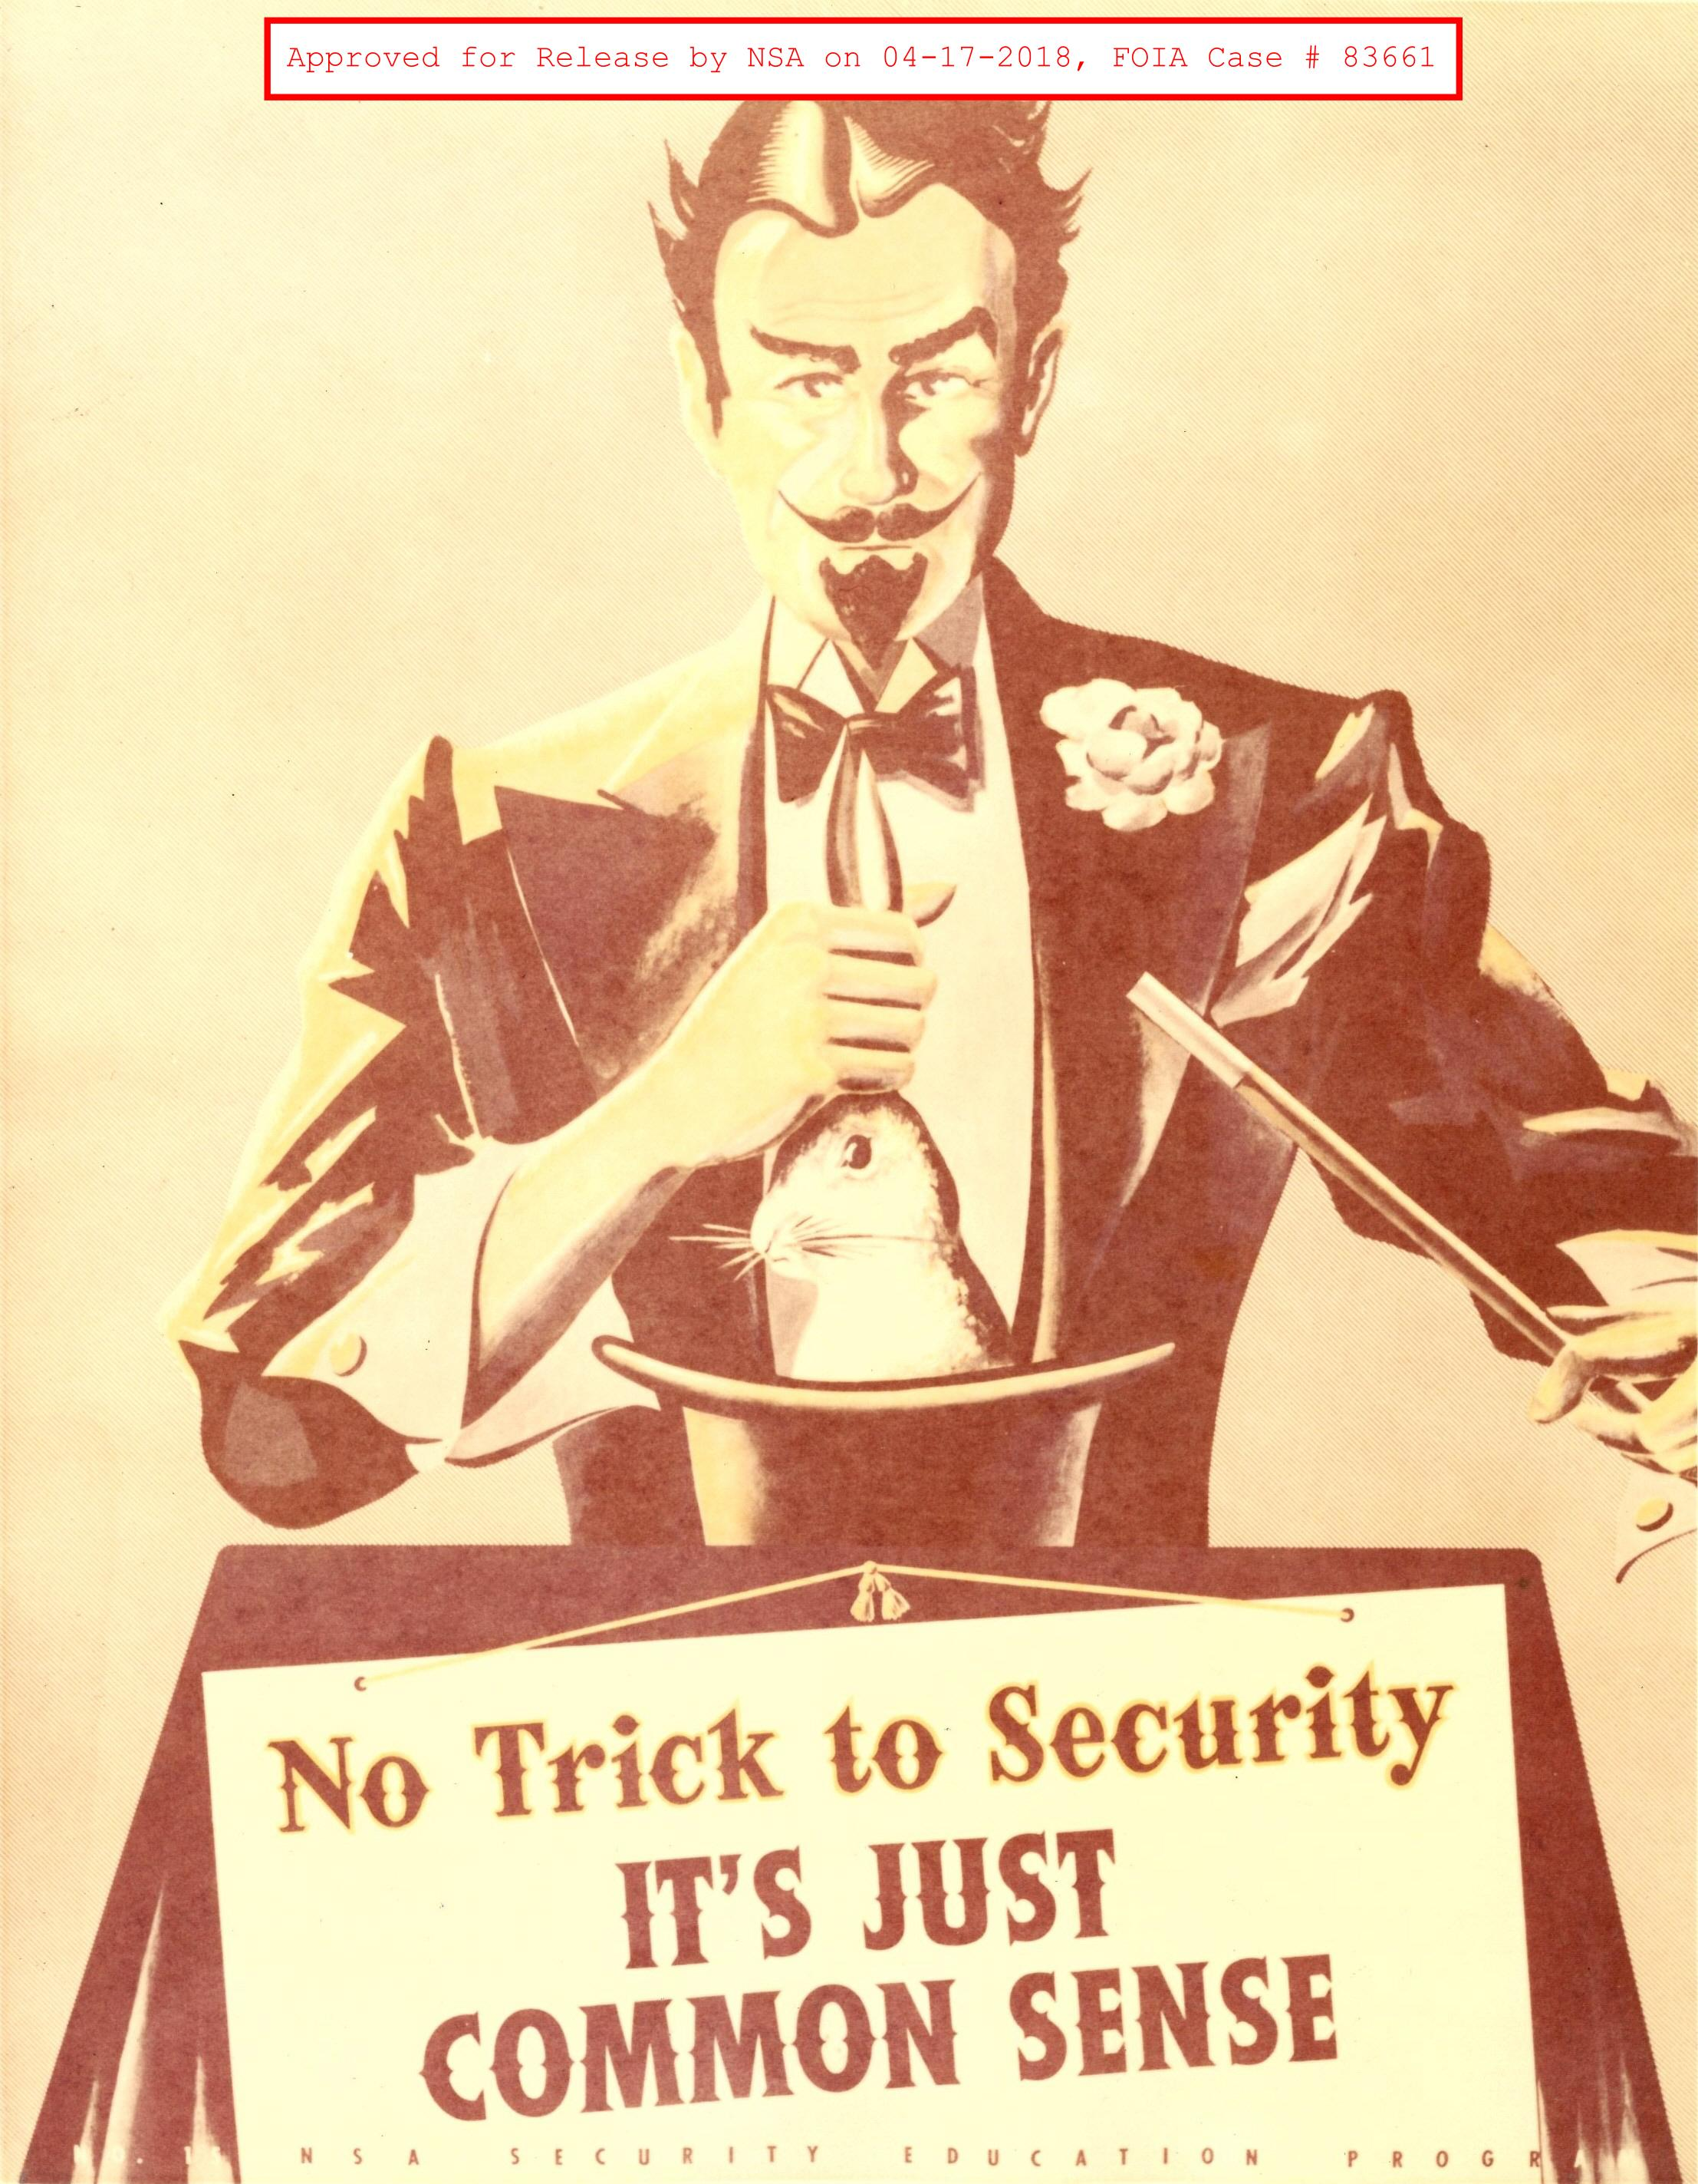
Asset
People
Property
Information/Data
An asset is what we are trying to protect

Slide 8
Threat
Anything that that represents a potential danger to an asset, whether deliberately or by accident
A threat is what we’re trying to protect against
Threat Agent is a group or individual who exploits a vulnerability to manifest or cause a threat to occur

Slide 9
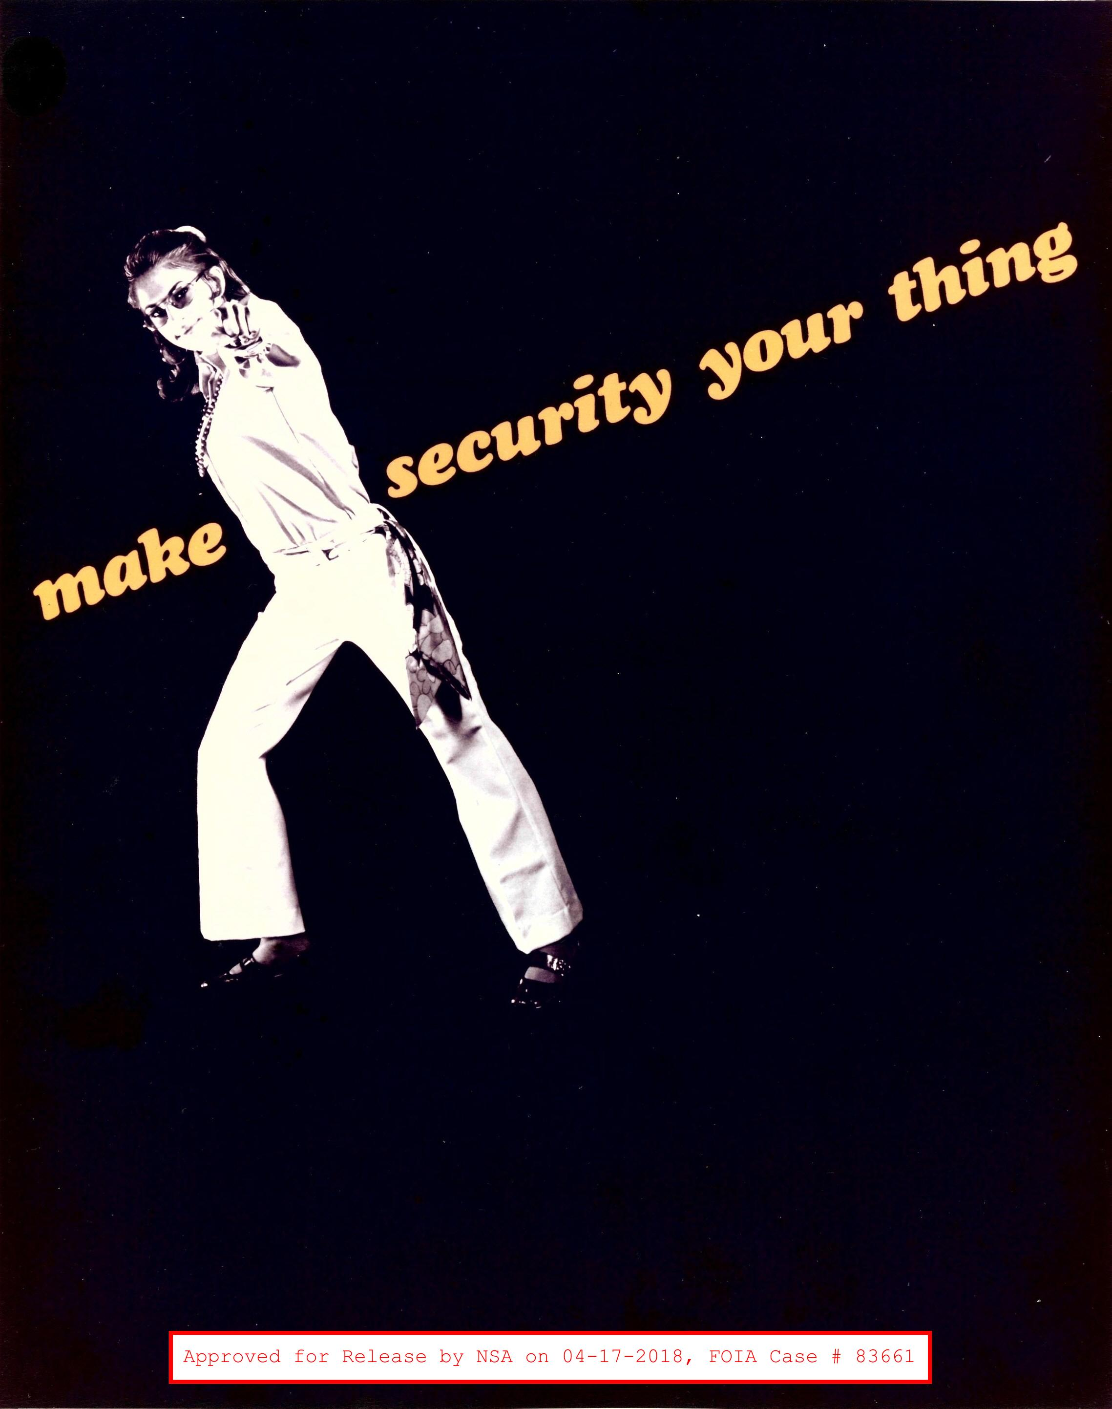
Vulnerability
Weakness or holes/gaps in security procedures or program that can be exploited by a threat to affect assets

Slide 10

What is “Risk”?
Asset = You
Threat = Rain
Vulnerability = Hole in your umbrella
Risk = you getting wet

Slide 11
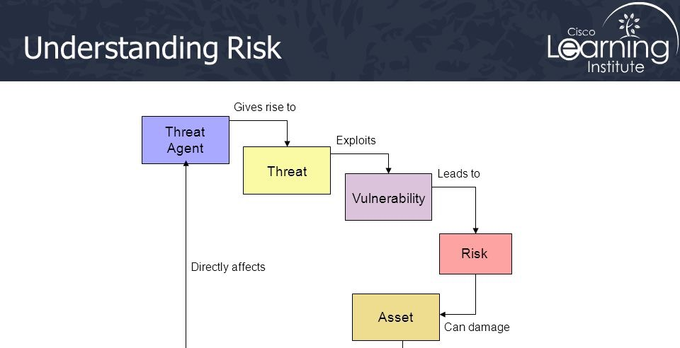
Notes:
threat agent - the entity that identifies a vulnerability and uses it to gain access or affect an asset
A threat agent is the facilitator of an attack, whereas a threat is a category of objects, persons, or other entities that represents a potential danger to an asset.
Exposure - potential to experience losses from a threat agent
possibly skip
Sauce: https://www.slideshare.net/AhmedHabib4/ccna-security-02-fundamentals-of-network-security

Slide 12
What is “Risk”?
The potential for loss, damage or destruction of an asset(s) as a result of a threat exploiting a vulnerability multiplied by the impact of the threat occurring
Notes:
minimizing risk therefore includes reducing any of the variables

Slide 13
Higher Education Assets
Network bandwidth and availability
Computing power
SEO reputation
Brand and reputation
Social Media accounts

Slide 14
Higher Education Assets
Personally Identifiable Information (PII) / Sensitive Personal Information (SPI)
Protected Health Information (PHI)
Confidential Intellectual Property
Export Controlled Data
National Security Interest (NSI)
Notes:
Export data - Information or technology deemed to be sensitive to national security or economic interests and subject to federal export control regulations as promulgated by the U.S. Departments of State and Commerce.
By working in HigherEd, and on the web, we collectively are all stewards of our institution’s assets. We all share a responsibility in their safe-keeping

Slide 16
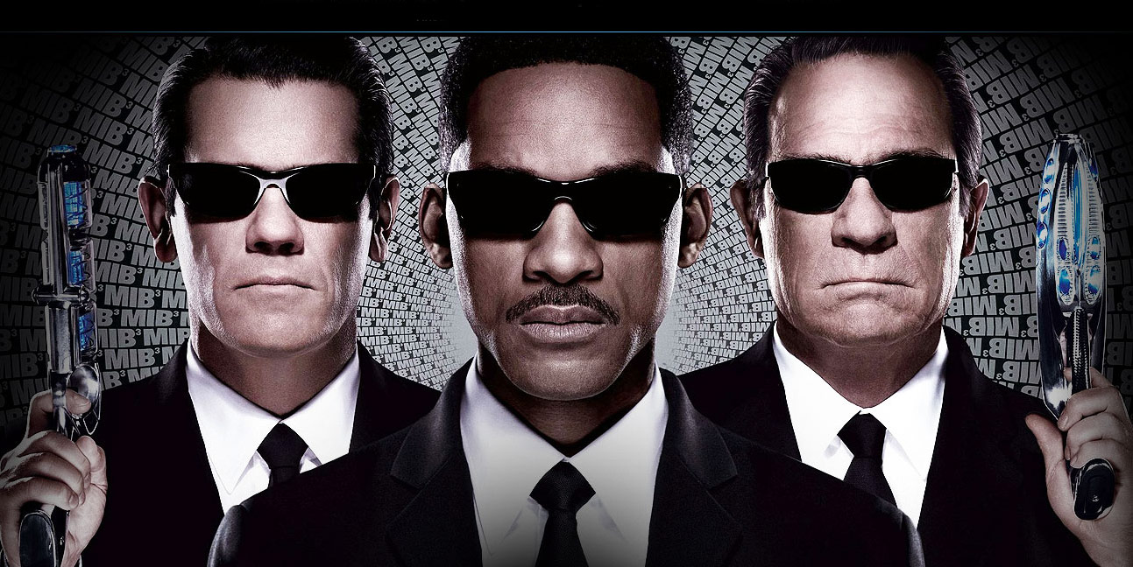
CIA Triad

Slide 17
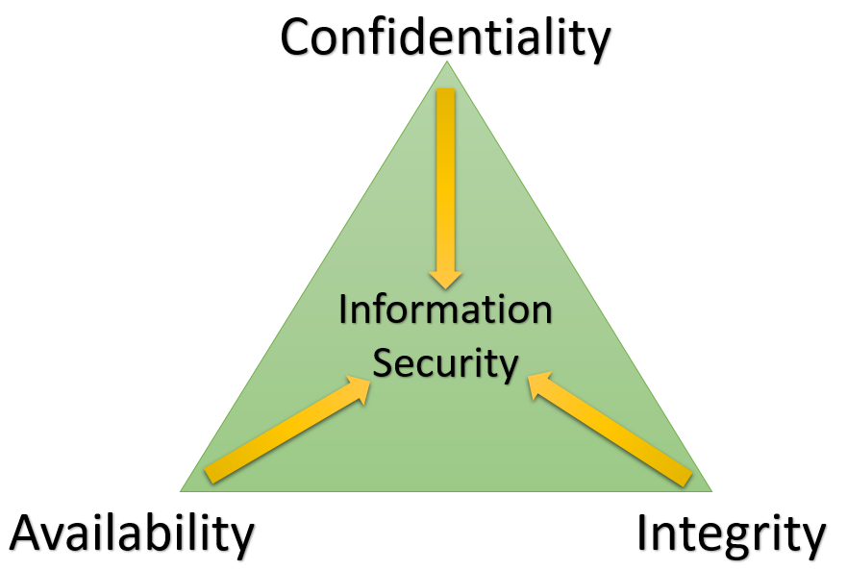
CIA Triad

Slide 18
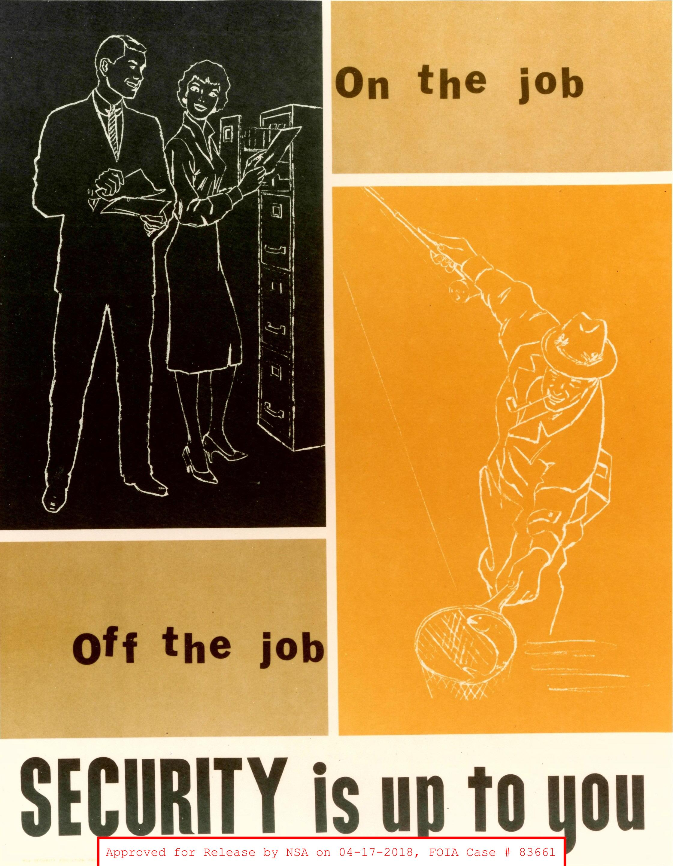
Know Your Assets
You can’t protect what you don’t know you have
Know your assets intimately
Notes:
Mention data/information and systems

Slide 19
Defense-in-Depth
Strategy of protection using a series of defensive mechanisms such that if one mechanism fails, another will already be in place to thwart an attack.
Notes:
with enough time, there’s a good chance they might succeed
we have to succeed 100% of the time, but an attacker only has to succeed once

Slide 20
Minimize the Attack Surface
The sum of all paths for data/commands into and out of the application
Plus all of the code that protects those paths
Plus all of the data used in the application
Plus all of the code that protects this data

Slide 21
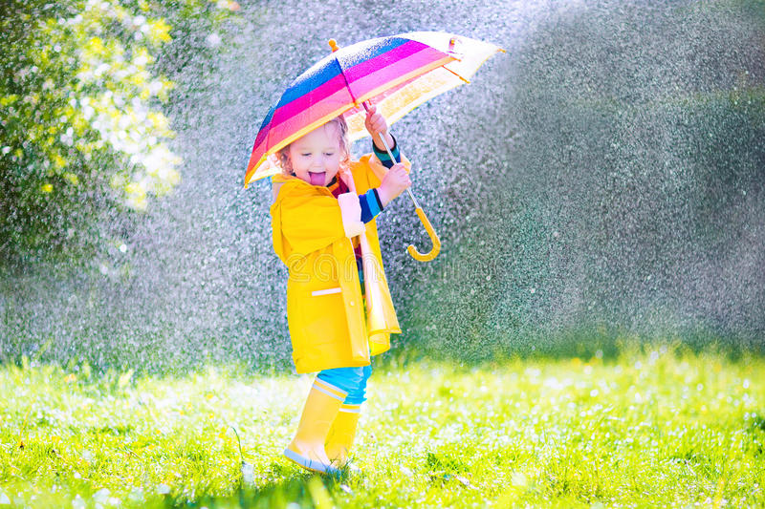
What is “Attack Surface”?
Notes:
also demonstrating Defense-in-depth

Slide 22
64.85.59.68 —> 64.85.0.0/16
Notes:
~4 billion ip addresses —> 65536 addresses

Slide 25
#3: Strong Passwords
What
Use a password that is long and contains randomized alpha characters, numbers and special characters
Does not contain common words in the dictionary
Why/How does it reduce risk?
More difficult for attackers (threat agents) to guess, and, historically, brute force
Prevent unauthorized access
Notes:
user name/password is the #1 method used for authentication

Slide 26
#3: Strong Passwords
Even more important than complexity is length
3 to 4 additional characters has the same entropy (number of possible combinations) as passwords using a more complex set of characters
Notes:
Show the calculator: https://www.grc.com/haystack.htm

Slide 27
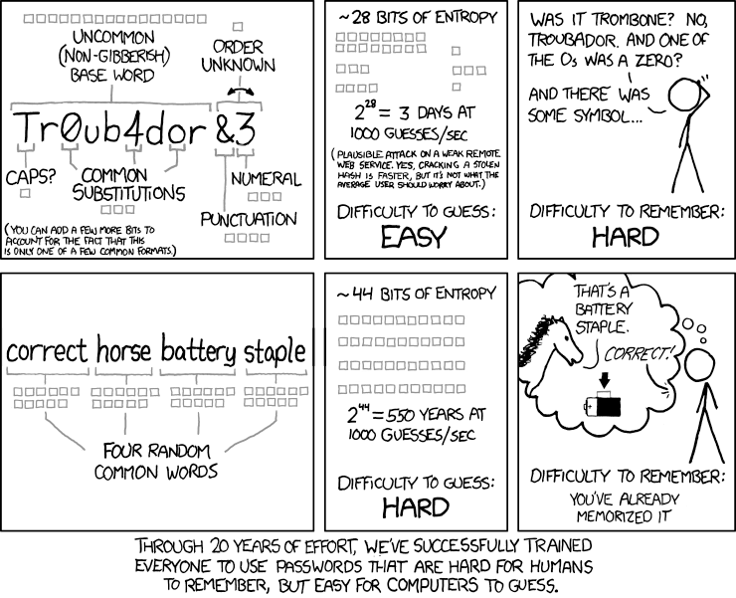
#3: Strong Passwords
https://xkcd.com/936/
Notes:
possibly remove

Slide 28
#3: Strong Passwords
But wait!

Slide 29
#3: Strong Passwords
What if we COMBINE them?!

Slide 30
#3: Strong Passwords
Your new password!
MF>E,D4,C!q^m,uSwVh.[2AD+JHsM^6}
Assuming one hundred billion guesses per second will take 6.22 million trillion trillion trillion centuries to brute force

Slide 31
#3: Strong Passwords
They need to be unique, for every account, on every site
As of 2017, 7 billion credentials have been leaked/exposed
Credential stuffing
Notes:
Mikey mentioned haveibeenpowned yesterday
Show a password brute force using the password with WPScan

Slide 32
#3: Strong Passwords
"R=.b8q%P5(fR74cZd3n<srtE?6c{X%`
$;@(:B&%hY^gt&QHV7t.4}y2:nnED:fe
Ah=4Rp9gb{zb5qW!`:K;5=R6]nDXD'PM
?fF*c,Xk&B<`WsCeeVLPNp{*/n5Nn4bC
ZkD=w{)PKG`<Z8*{)&RdjV{$XZ#L:RnA
7E?#!+5+b){CyM,p@r.U;WW6sFM%%5j"
b-46dy+=V-_Vu-8tU=k.*]Ne%/5k2D#e

Slide 33
#3: Strong Passwords
Use a password manager
No, really: use a password manager
Enforce strong, unique passwords for everyone
Integrate with your institution’s single-sign-on system
Use a strong, unique, and long password everywhere, not just in WordPress
Notes:
Mention lacy’s lightning talk
Mention password padding if they wont/cant use a password manager

Slide 34
Principle of Least Privilege
Grant necessary permissions required to perform the intended activities
For a limited time
But with the minimum rights required for the task(s)
Removing permissions when no longer needed
Notes:
Doing so ensures the user/service is unable to perform actions they are not authorized to perform or access data they are not authorized to access
Limits the effects of changes to the area in which they’re made
e.g. limit user roles in systems

Slide 35
Be Paranoid
Jessica Paul, your paranoia is exhausting
Notes:
Security teams always say “no”

Slide 36
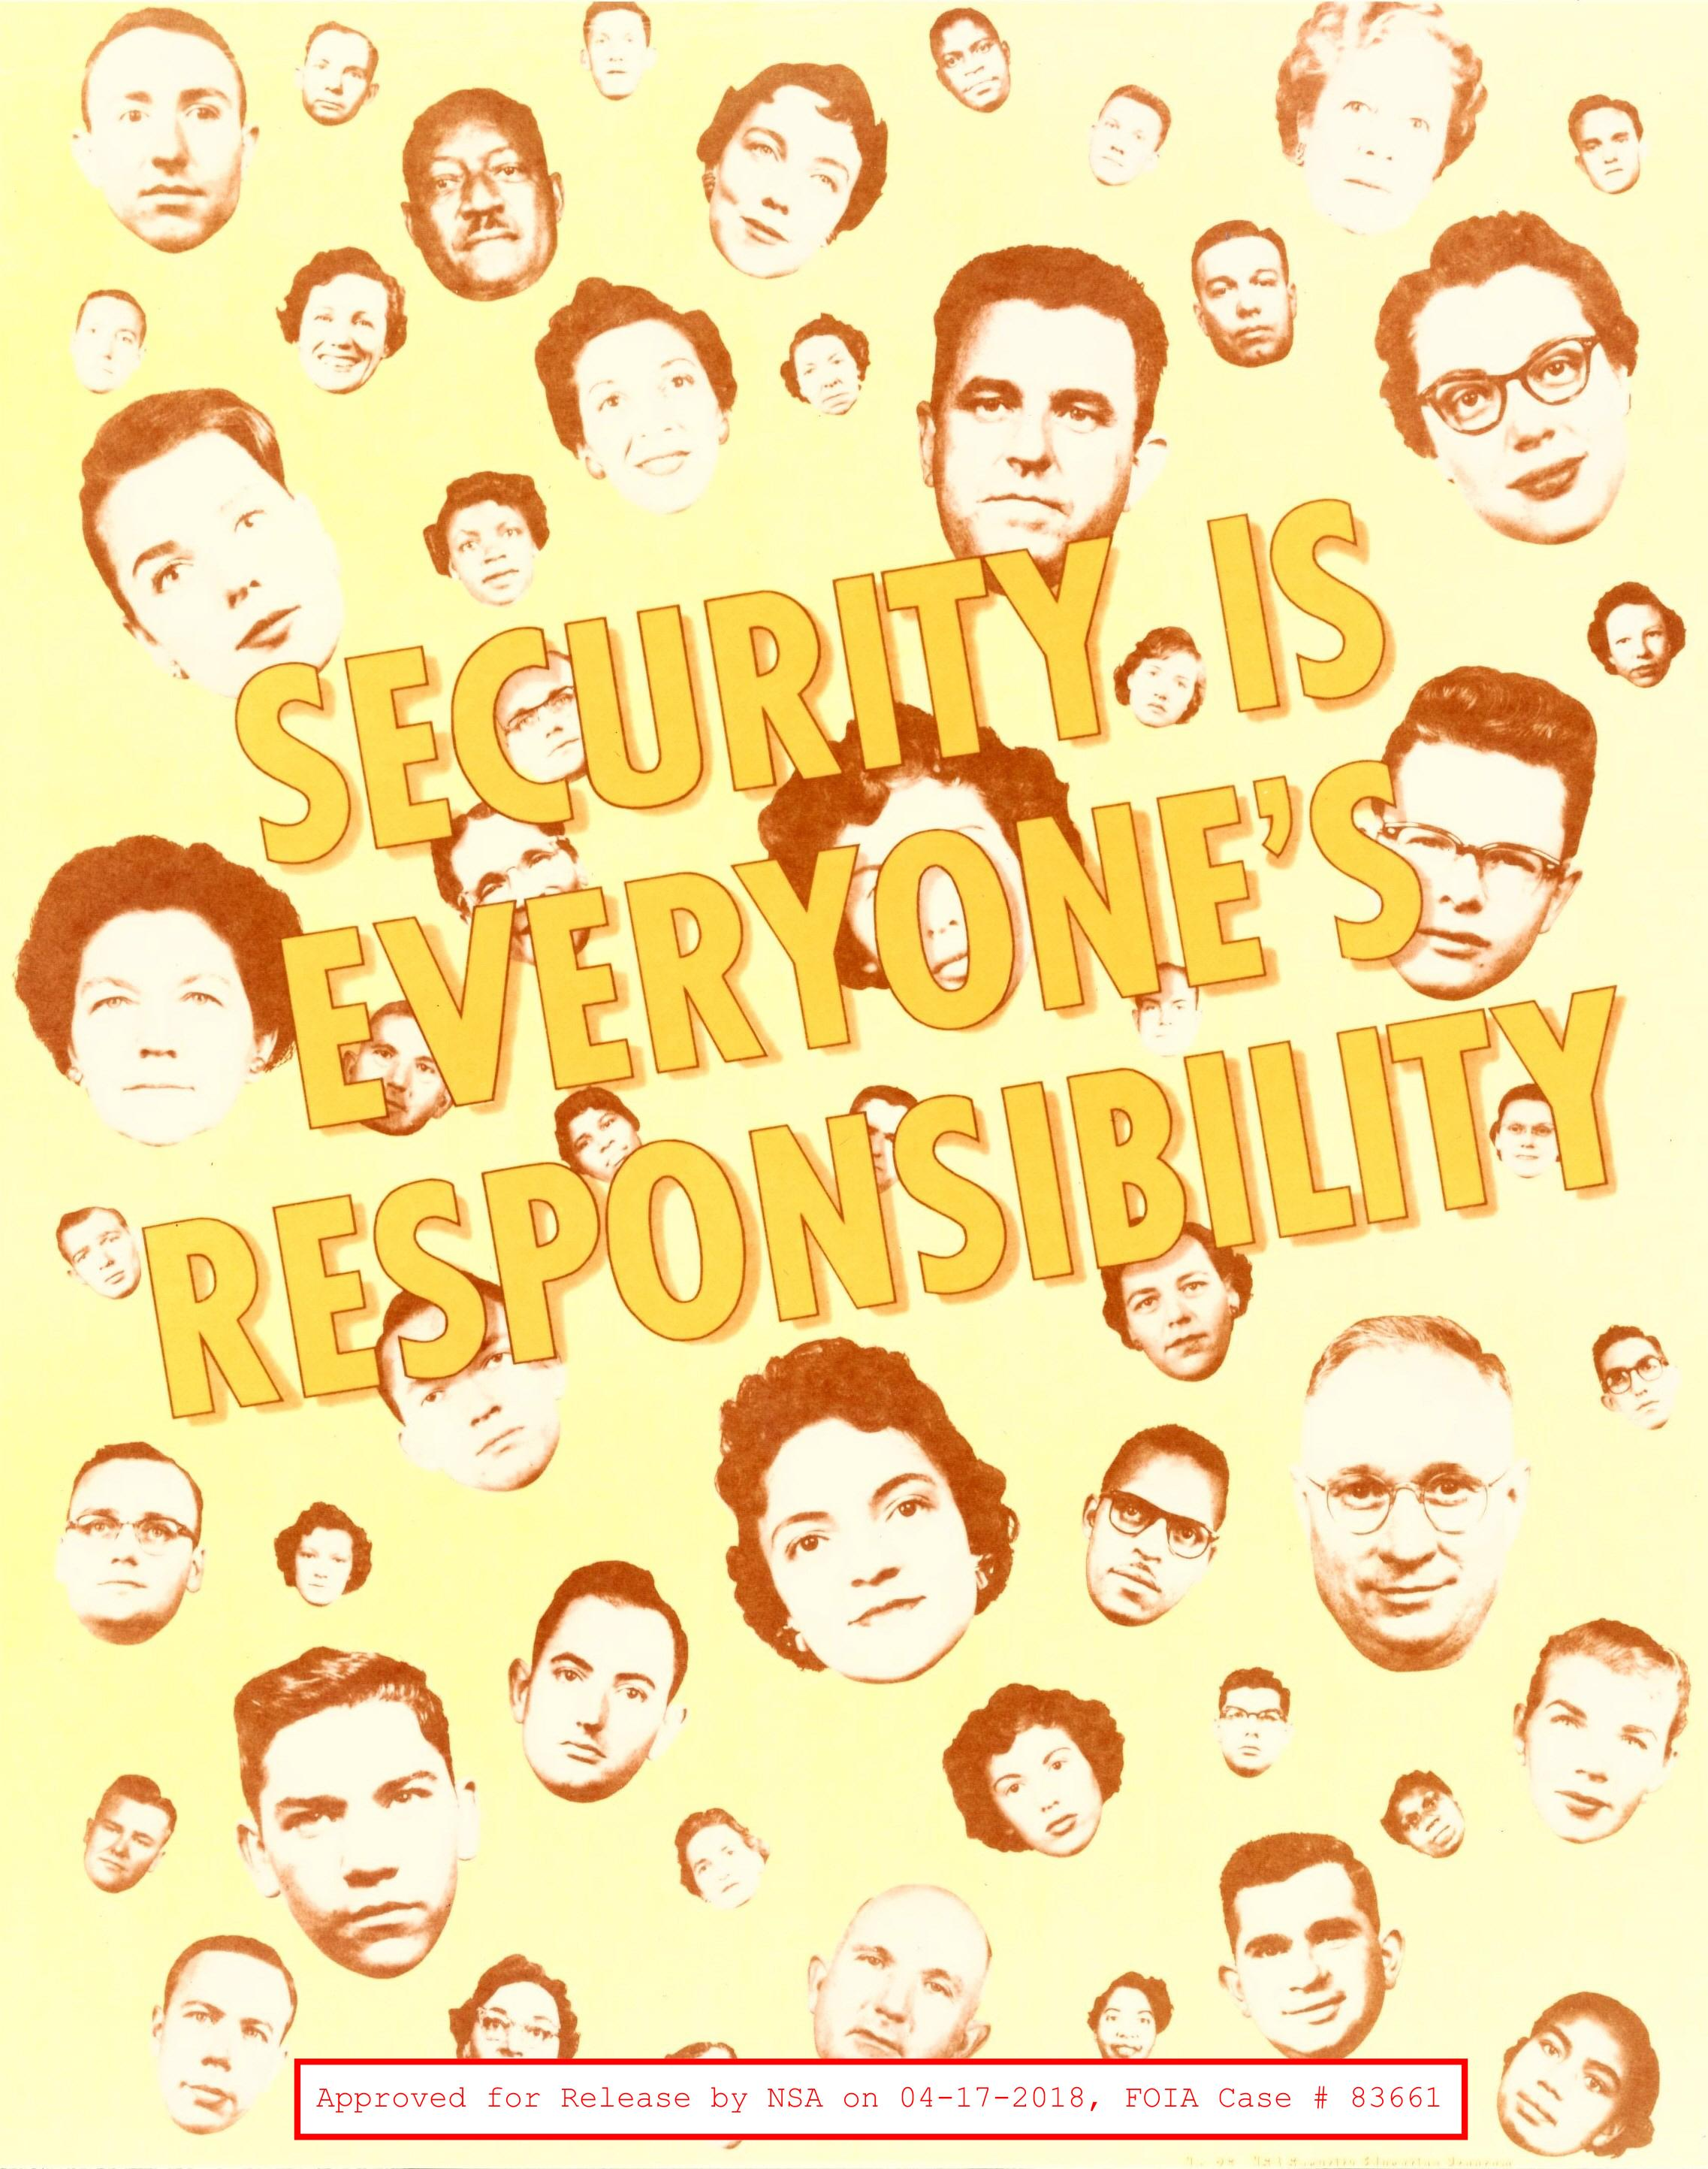
Ok, How About: “Be Skeptical”
Treat all third party code/data as tainted and hostile
Humans remain the weakest link in the InfoSec armor
Notes:
Third party code more than likely have differing security policies and posture than you

Slide 37
Security is a continual process; you’re never “finished”
Notes:
New threats emerge, new vulnerabilities are discovered

Slide 38
Your Challenge
Always be thinking in terms of how you can reduce risk

Slide 39
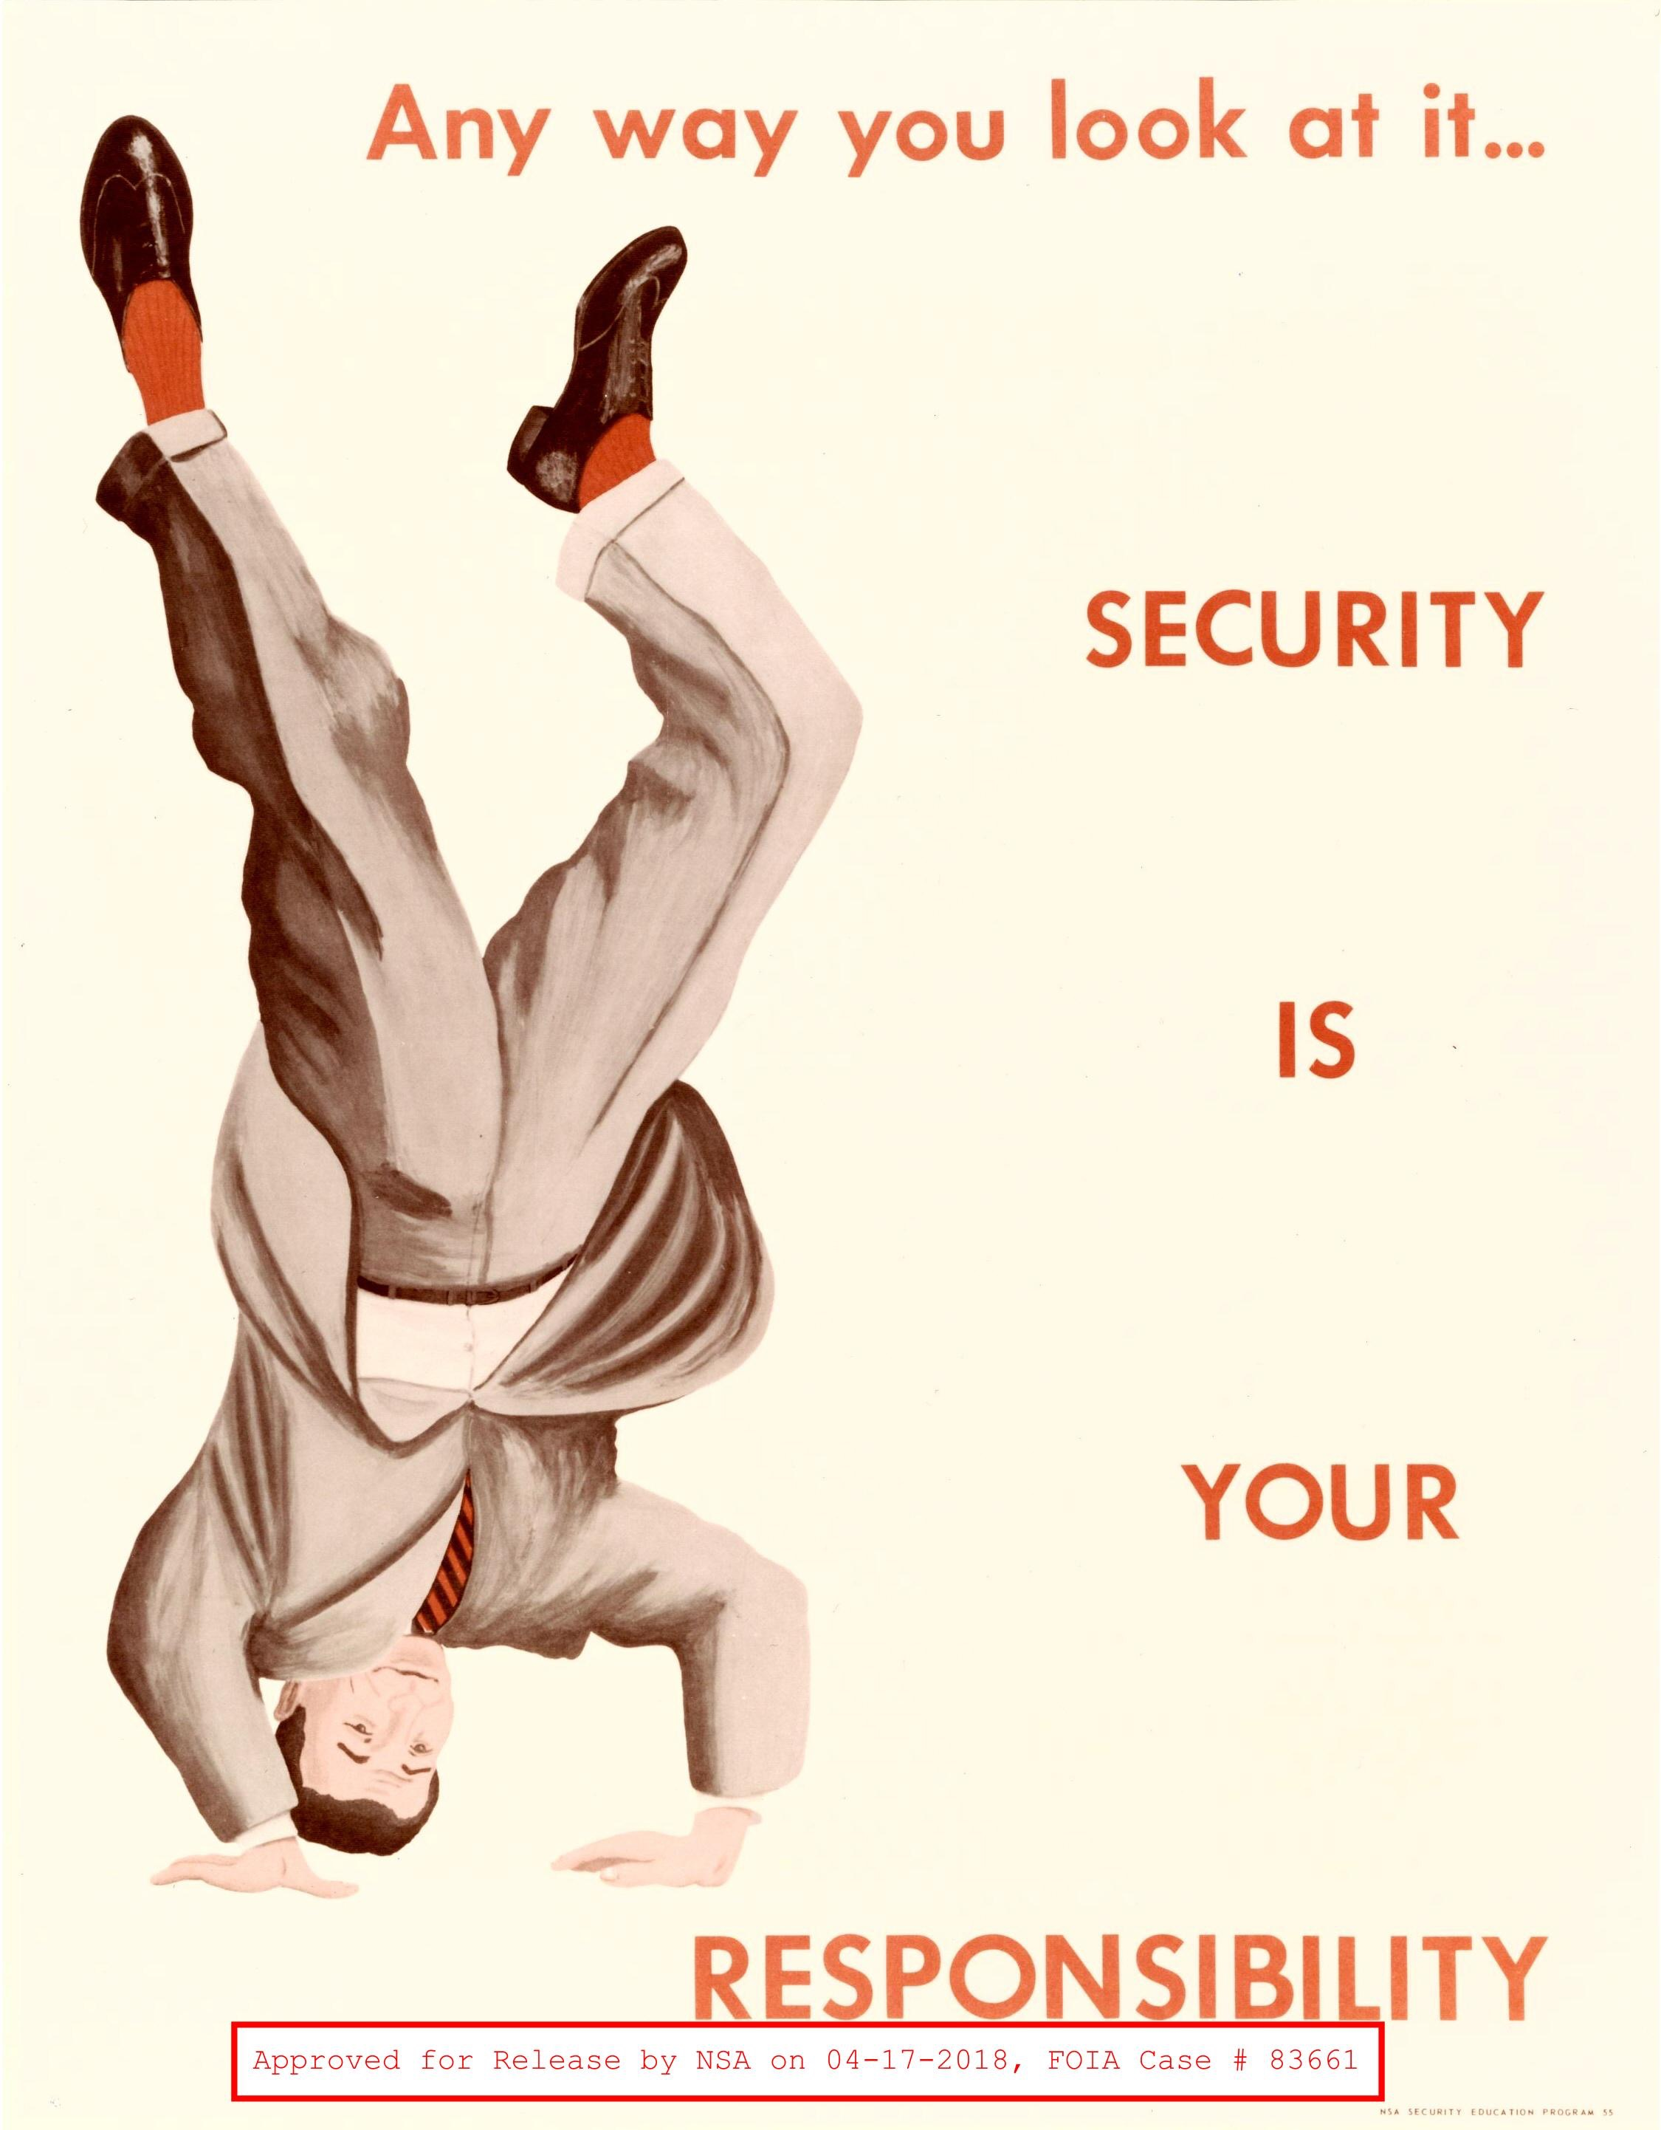
Always be thinking in terms of how you can reduce risk

Slide 40
Paul Gilzow
Programmer/Analyst / Security Analyst at the University of Missouri
Contact
gilzow@missouri.edu
@gilzow on twitter
https://fb.me/gilzow
https://profiles.wordpress.org/gilzow
https://github.com/gilzow/

Slide 41
Questions
WHAT QUESTIONS DO YOU HAVE FOR ME?

